Slide 1
student Course Cards 2022-2023

Slide 2
Our Principal
Ms. Athanson
Principal

Slide 3
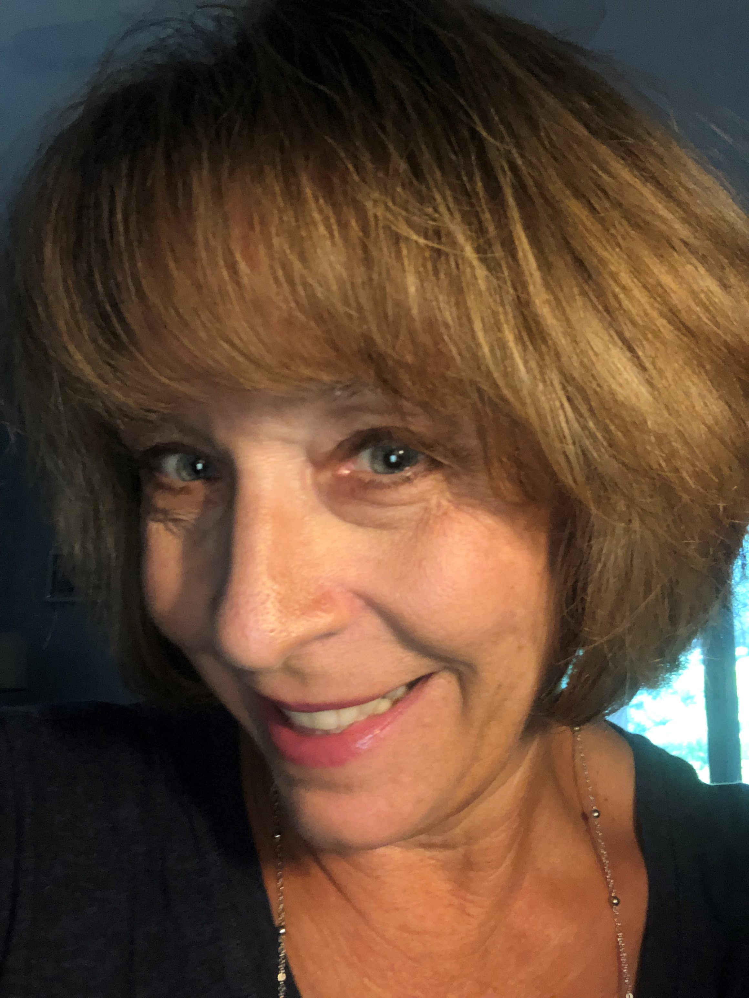
6TH GRADE OFFICE STAFF
Dr. Wynn
6th grade Assistant Principal
Ms. O’Connor
6th grade Clerk

Slide 4
6th Grade counselor Ms. Hill Hillkia@pcsb.org
This is my 2nd year as a school Counselor.
I was a 1st and 2nd grade teacher for 7 years at highland lakes Elementary School.

Slide 5
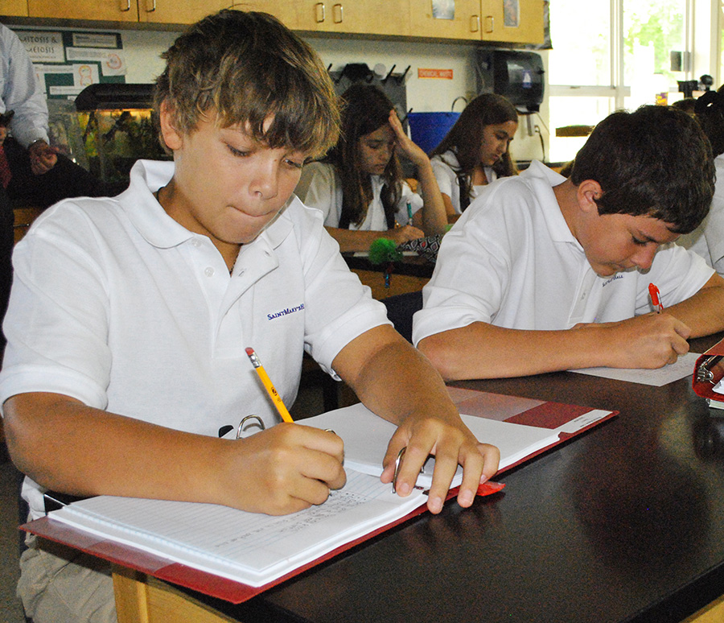
STUDENTS WILL BE PLACED IN CORE ACADEMICS BASED ON FSA scores, GRADES, ETC.
This Photo by Unknown Author is licensed under CC BY-NC-ND
Language Arts
Math
Science
Social Studies
This Photo by Unknown Author is licensed under CC BY-SA

Slide 6
Reading
Students who earn a level 1 or 2 on the fsa reading will be placed in an intensive reading class next school year.
Reading will take the place of one of your electives

Slide 7
PE requirements
6th graders are required to take pe
You have 2 choices (only pick 1)
Full year pe (August- May)
SEMESTER PE AND SEMESTER OF COMPUTER BUSINESS APPLICATION 1

Slide 8
Course card example

Slide 9
Electives at palm HARBOR MIDDLE SCHOOL
BAND (full year)
ORCHESTRA (FULL YEAR)
CHORUS (FULL YEAR)
Information & Communication Tech Essentials (FULL YEAR)
Spanish 1 (full year)
AVID *application required Will be enrolled into at least one advanced class (FULL YEAR)
Intro to Manufacturing & Career Planning (Robotics) and Exploring Technology & Career Planning (Woodshop) (each of these are SEMESTER COURSE)
Visual Art 1 and Visual Art 2 (each of these are SEMESTER COURSE)

Slide 10
Thank You!☺
Please feel free to reach out to me if you have any questions or concerns!
Ms. Hill (6th grade) – Hillkia@pcsb.org

